Slide 1
Netflix Stock Performance
Capstone 2
8/21/2018
Le Tran

Slide 2
Objective
The Stock Profile Team has been tasked to develop visualizations through research and analysis for a stock profile of Netflix (NFLX).
Our goal in the Stock Profile Team is to provide visualizations to help financial analysts assess the risk of the Netflix stock in the year 2017.

Slide 3
Steps Taken
Analysis of Netflix (NFLX) stock price, daily and quarterly
Analysis of Netflix (NFLX) monthly stock price
Analysis of Dow Jones (DJI) monthly stock price
NFLX & DJI Comparison

Slide 4
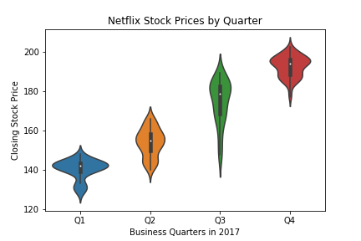
NFLX Stock Price
NFLX stock was analyzed and a violin plot was used to view the distribution each quarter
NFLX price increased throughout 2017

Slide 5
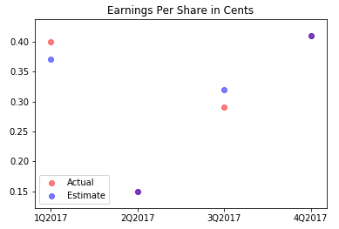
Netflix EPS
Based on the data that was analyzed, NFLX met its estimated EPS in the second and fourth quarter, exceeded its estimated EPS in the first quarter, but fell a little short in the third.

Slide 6
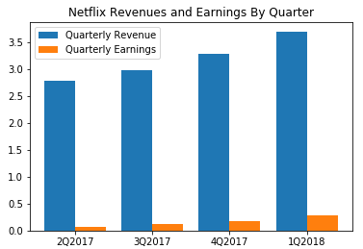
NFLX Revenues/Earnings
NFLX saw revenues and earnings increase every quarter throughout 2017 and into 2018
The percentage of revenues that constitute earnings is roughly between 2.0-5.0%

Slide 7
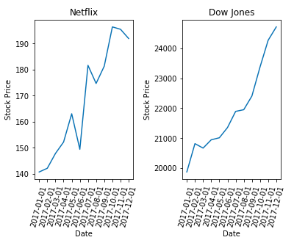
Netflix vs Dow Jones
NFLX performed fairly relative to the Dow Jones
NFLX appears to be more volatile, even though the stock price has increased, but between May and June, NFLX price had a bit of a drop.
DJI appears to have a steadier growth

